Slide 1
Running C# on VS Code
Environment Setup

Slide 2
Download .Net 5 SDK
Download .NET 5.0 SDK (v5.0.408) - Windows x64 Installer (microsoft.com)

Slide 3
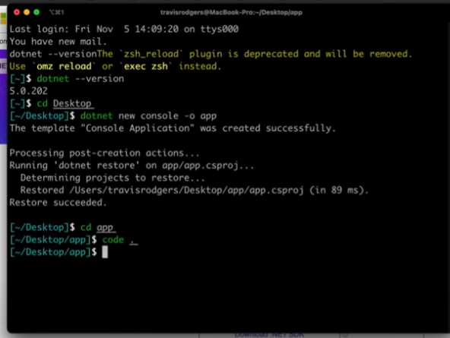
dotnet new console –o app

Slide 4
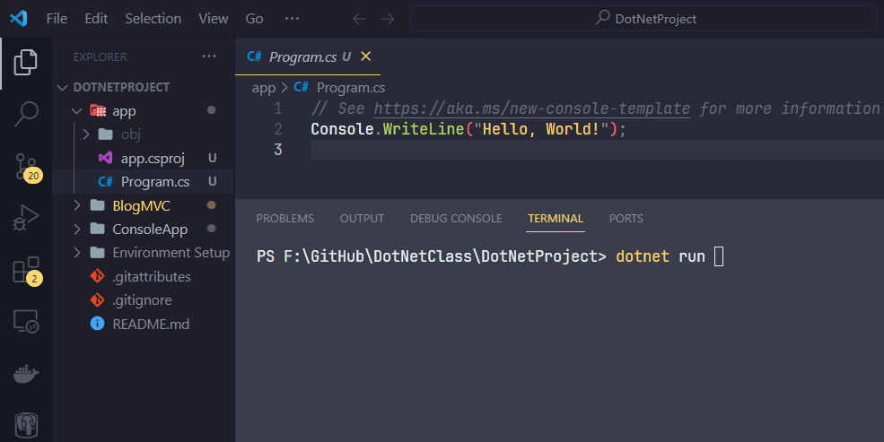
Open project in VS Code and dotnet run

Slide 5


Slide 6
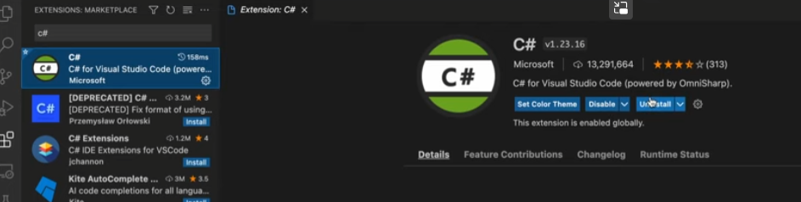
C Sharp Extension

Slide 7
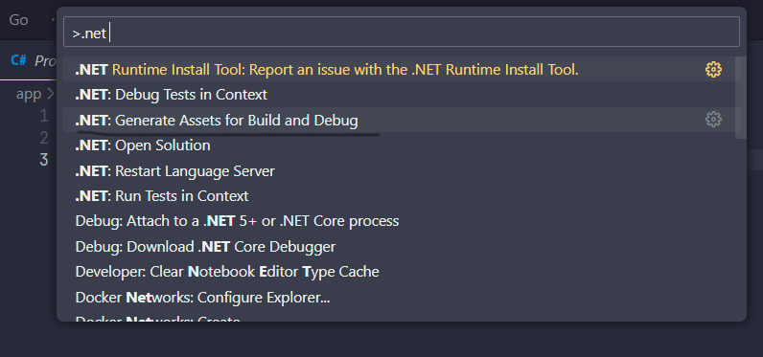
Debugging C# in VS Code

Slide 8
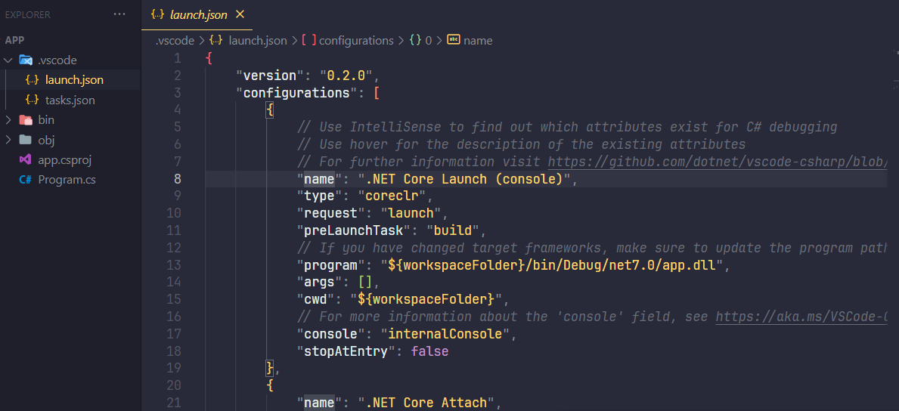
Debugging C# in VS Code

Slide 9
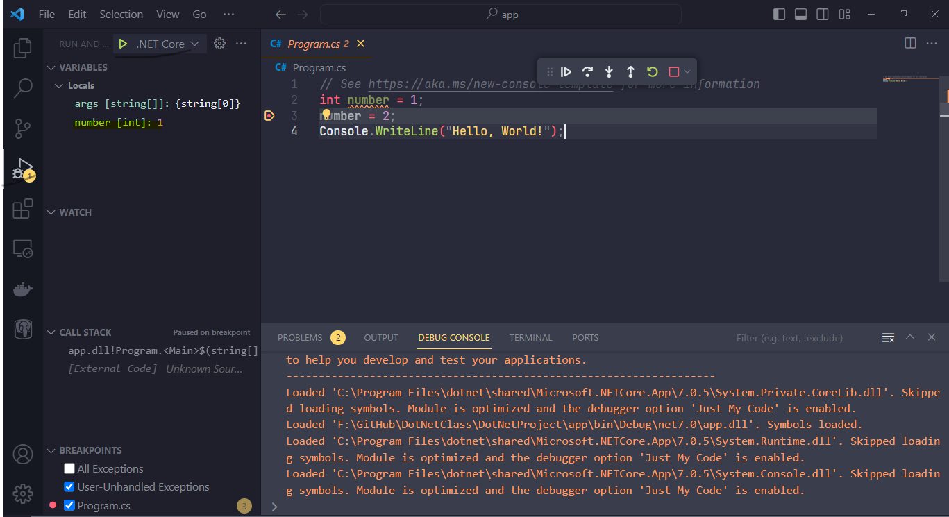
Setting Breakpoints

Slide 10
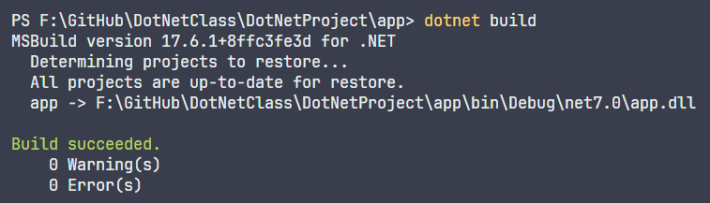
Building project

